Slide 1

Error Component models
Ric Scarpa
Prepared for the Choice Modelling Workshop
1st and 2nd of May
Brisbane Powerhouse,
New Farm
Brisbane

Slide 2
Presentation structure
The basic MNL model
Types of Heteroskedasticy in logit models
Structure of error components
Estimation
Applications in env. economics
  Flexible substitution patterns
  Choice modeling
Future perspectives (debate)

Slide 3
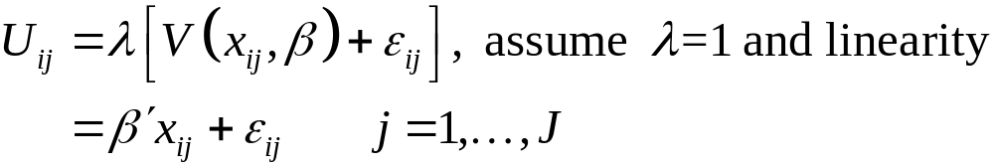

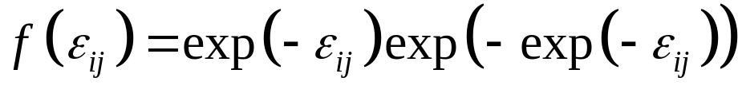
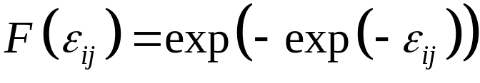
ML – RUM Specification
The utility from individual i choosing alternative j is given by:
Assume error is Gumbel
i.e.,

Slide 4
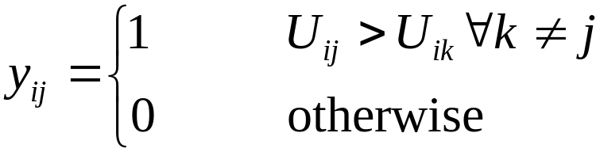
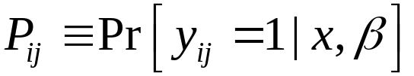
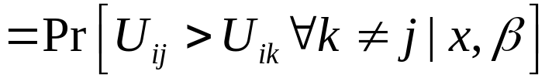
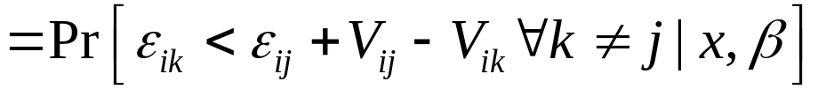
ML Choice Probabilities
Given the distributional assumptions and representative agent specification, then defining
we have that:

Slide 5
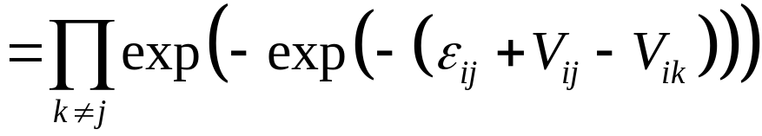

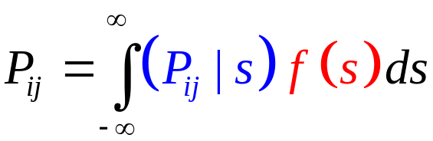
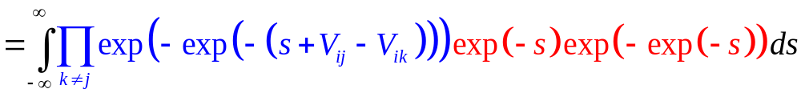
ML Choice Probabilities (cont’d)
Thus, we have the conditional choice probability:
Taking the expectation of this with respect to yields the unconditional choice probability:

Slide 6
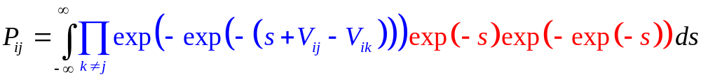
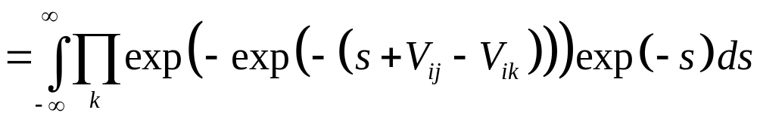
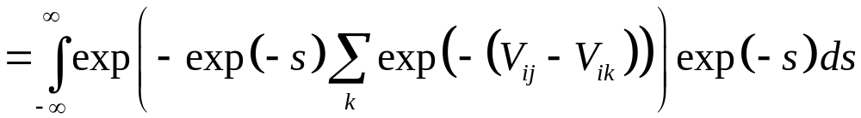

ML Choice Probabilities (cont’d)
Consider a change of variables

Slide 7
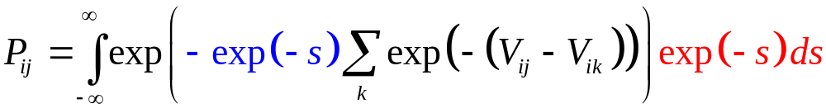
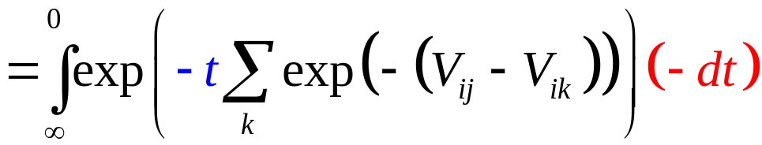
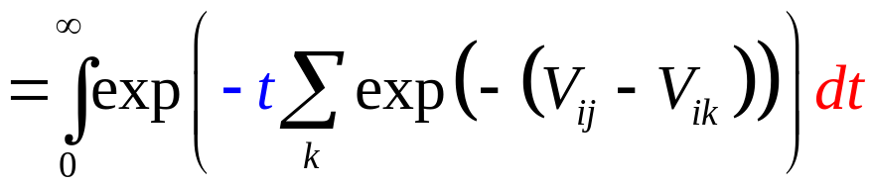
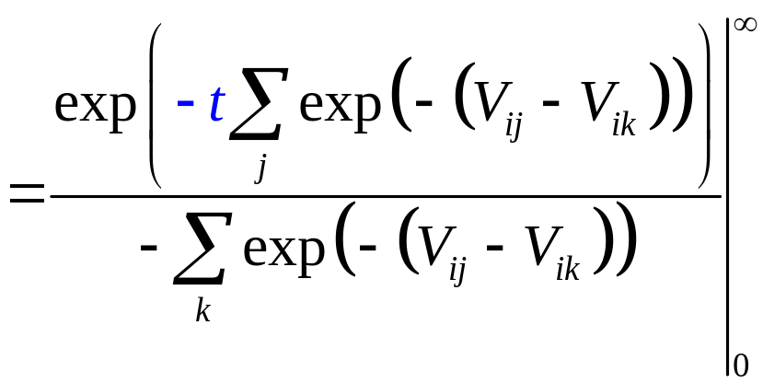
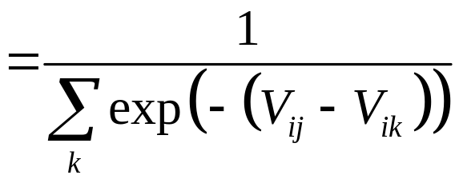
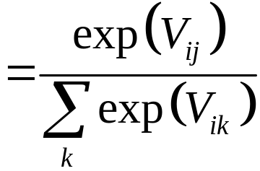
ML Choice Probabilities (cont’d)

Slide 8
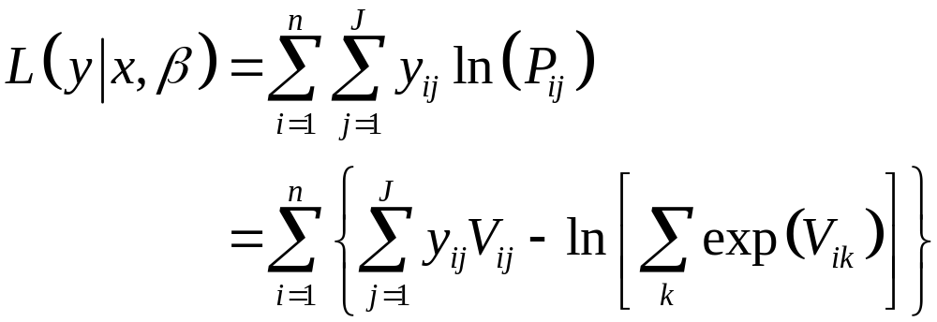
Merits of ML Specification
The log-likelihood function has a relatively simple form
The log-likelihood model is globally concave in its parameters (McFadden, 1973)
Choice probabilities lie strictly within the unit interval and sum to one

Slide 9
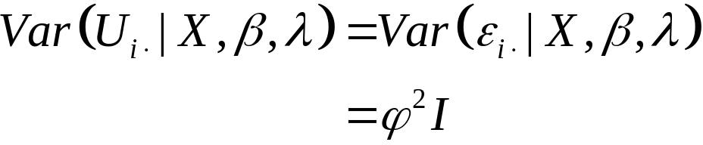
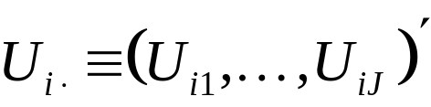
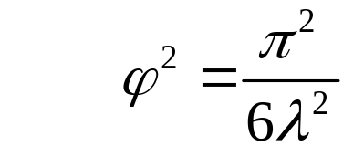
Utility Variance in ML Specifications
Assumes that the unobserved sources of heterogeneity are independently and identically distributed across individuals and alternatives; i.e.,
where and
Dependent on λ, but basically homoskedastic in most applications
This is a problem as it leads to biased estimates if variance of utilities actually varies in real life, which is likely phenomenon
Because the effect is multiplicative bias is likely to be big

Slide 10
Scale heteroskedasticy
…or Gumbel error heteroskedasticity
SP/RP joint response analysis allowed for minimal heteroskedasticty (variance switch from SP to RP): λ_{i}=exp(α×1_{i}(RP))
Choice complexity work introduced λ_{i}=exp(γ’z_{i}), where z_{i} is measure of complexity of choice context i
Respondent cognitive effort: ϕ_{n}=exp(θ’s_{n}), where s_{n} is a measure of cognitive ability of respondent n

Slide 11
Scale Het. limitations
While scale heteroskedasticity allows the treatment of heteroskedasticity in the choice-respondent context it does not allow heteroskedasticity across utilities in the same choice context
People may inherently associate more utility variance with less familiar alternatives (e.g. unknown destinations, hypothetical alternatives) than with better known ones (e.g. frequently attended sites, status quo option)

Slide 12
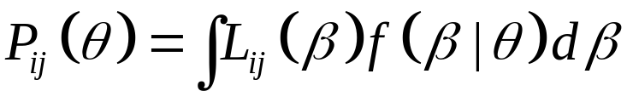

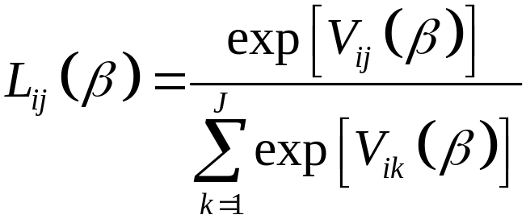




Mixed logit
The mixed logit model is defined as any model whose choice probabilities can be expressed as
where is a logit choice probability; i.e.,
and is the density function for , with underlying parameters
denotes the representative utility function

Slide 13
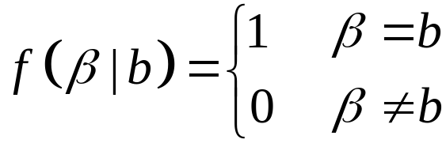
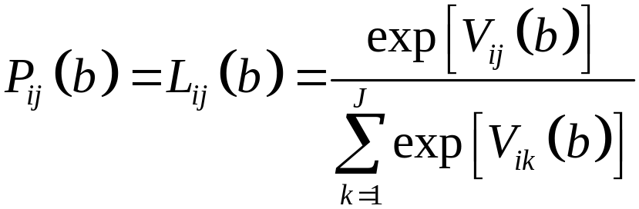
Special Cases
Case #1: MNL results if the density function is degenerate; i.e.,

Slide 14
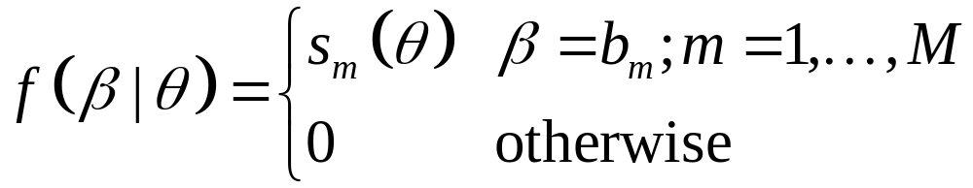
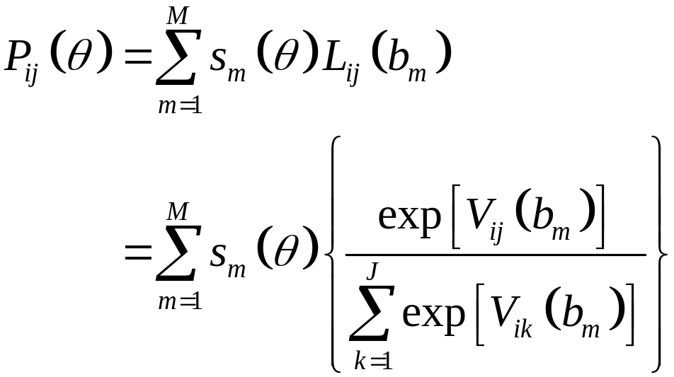
Special Cases
Case #2: Finite mixture logit model results if the density function is discrete; i.e.,

Slide 15
Notes on Mixed Logit (MXL)
Mixed logit probabilities are simply weighted average of logit probabilities, with weights given by
The goal of the research is to estimate the underlying parameter vector
Train emphasizes two interpretations of the MXL model
  Random parameters (variation of taste intensities)
  Error components (heteroskedastic utilities)

Slide 16
Simulation Estimation
Simulation methods are typically used to estimate mixed logit models
Recall that the choice probabilities are given by
where

Slide 17

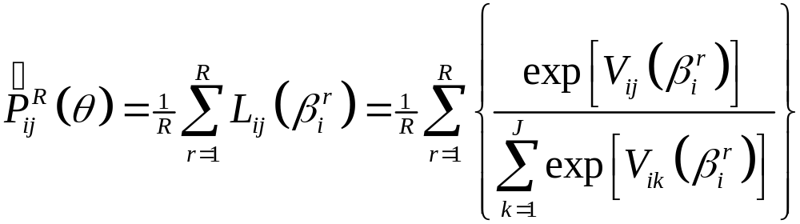
Simulation Estimation
(cont’d)
For any given value of , one can generate
drawn from
which can then be used to compute

Slide 18
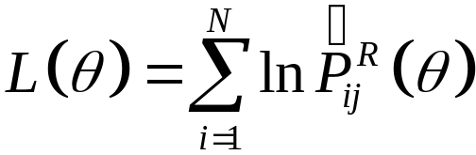
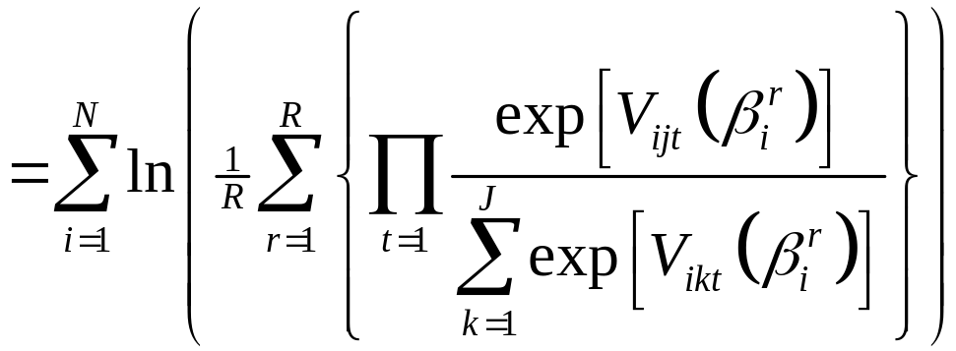
Simulation Estimation
The simulated log-likelihood for the panel of t choices becomes:

Slide 19
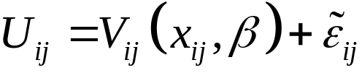




Error Components Interpretation
The mixed logit model is generated in the RUM model by assuming that
where
with x_{ij} and both observed,
and

Slide 20
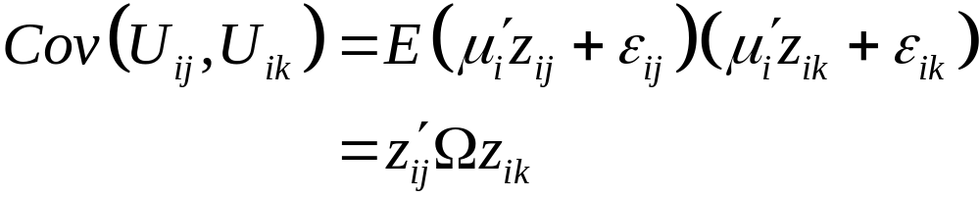
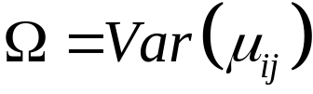
Error Components Interpretation
(cont’d)
The error components perspective views the additional random terms as tools for inducing specific patterns of correlation across alternatives.
where

Slide 21
Example – Mimicking NL
Consider a nesting structure
Take a trip
Stay at home (j=0)
Nest A
Nest B
1
2
3
4

Slide 22
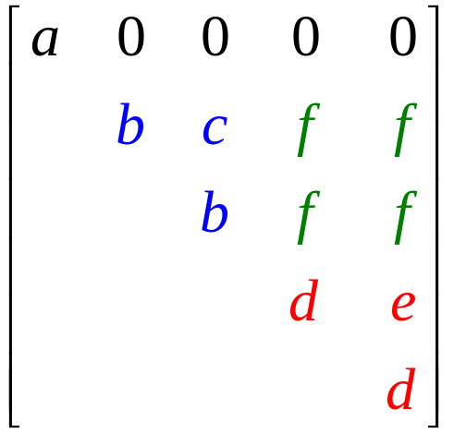
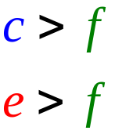
Example (cont’d)
The corresponding correlation structure among error components (and utilities) is given by
where

Slide 23
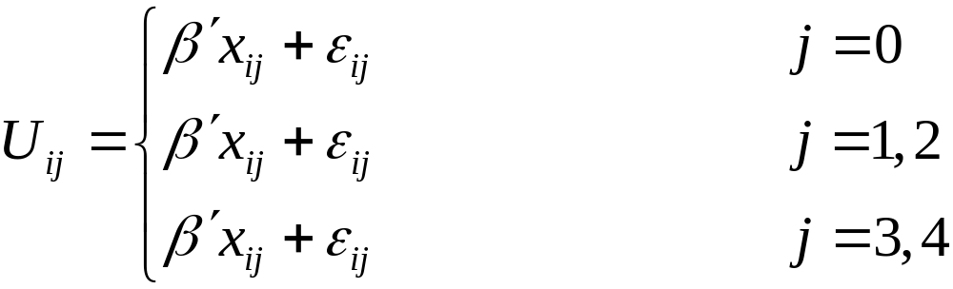



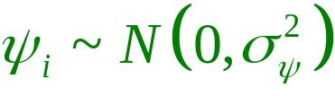
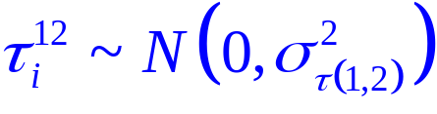
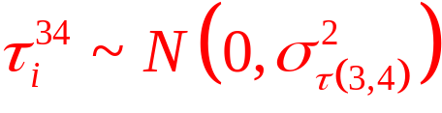
Example (cont’d)
We can build up this covariance structure using error components
with

Slide 24
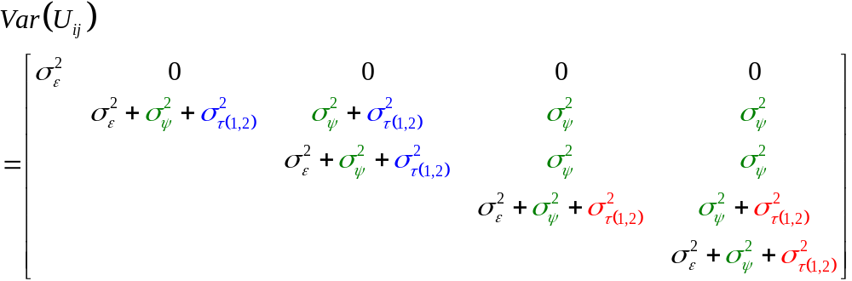
Example (cont’d)
The resulting covariance structure becomes

Slide 25
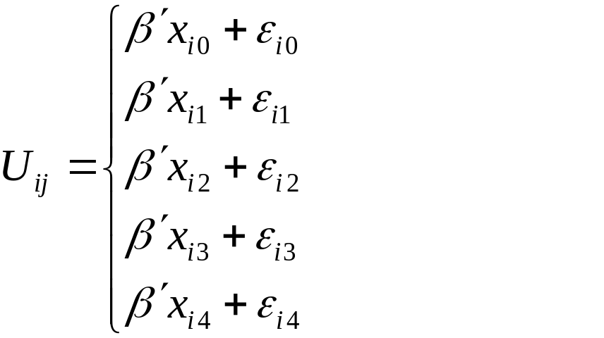




Example (cont’d)
One limitation of the NL model is that one has to fix the nesting structure
MXL can be used to create overlapping nests

Slide 26












Herriges and Phaneuf (2002)
Covariance Pattern
 | 1.88 | 2.14
 | -- | 1.30
 | -- | 0.64
 | 1.61 | 1.09
 | -- | 0.93
 | -- | 0.58
 | 1.61
 | -- | 1.72
 | -- | 0.08
 | -- | 0.46
 | -- | 0.35
 | -- | 0.56

Slide 27
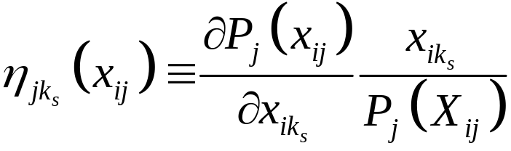
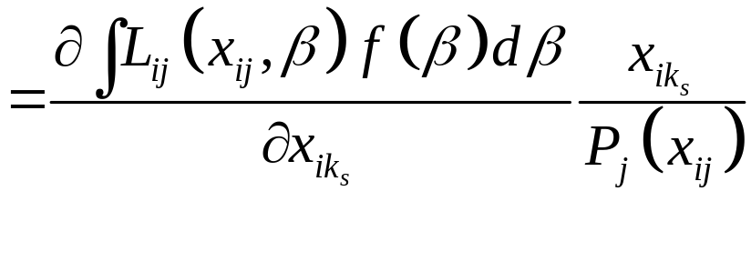
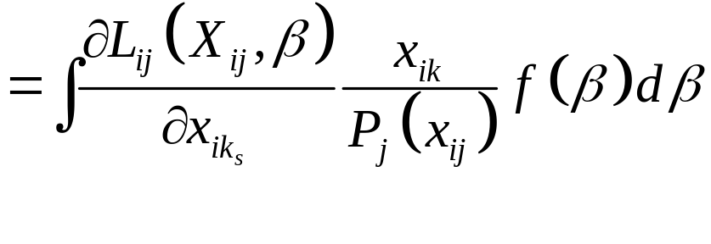
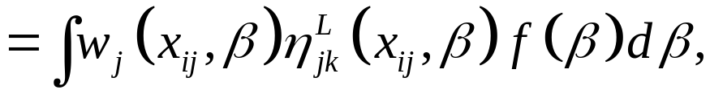
Implications for Elasticity Patterns
In general, elasticities given by

Slide 28
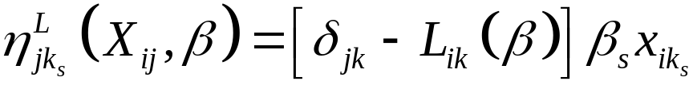

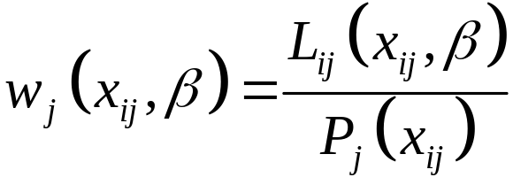
Implications for Elasticity Patterns
(cont’d)
where
denotes the standard logit response elasticity (i.e., without nesting) conditional on a specific draw of the vector
and
denotes the relative odds that alternative j is selected
(i.e., conditional versus unconditional odds)

Slide 29
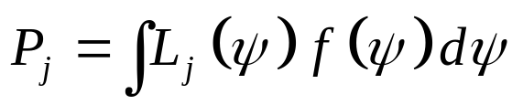







Illustration – Choice Probabilities
 | 0.65 | 0.20 | 0.03 | 0.20 | 0.45
 | 0.09 | 0.20 | 0.24 | 0.20 | 0.14

Slide 30


Choice modeling
Error component in hypothetical alternatives, yet absent in the SQ or no alternative
The induced variance structure across utilities is:

Slide 31
Effect
Fairly general result that it improves fit while requiring few additional parameters (only st. dev. of err. comp.)
It can be decomposed by socio-economics covariates (e.g. spread of error varies across segments of respondents)

Slide 32
Adoption and state of practice
Error component estimators have now been incorporated in commercial software (e.g. Nlogit 4)
Given their properties and the flexibility they afford they are likely to be increasingly used in practice

